Slide 1

Final Report Police dispatched incidents
202120 – DATA-201-23387
Minh Tu Bui

Slide 2
Agenda
Data Ingestion and Wrangling
Exploratory Data Analysis
Final Data Products
Time-series forecast
Optimal location
Limitations
Research Outlooks
Notes:
ex'ploratory, a'nalysis

Slide 3
Data Ingestion and Wrangling
“Police Dispatched Incidents” Dataset
Source: DataMontgomery (url)
Description: records of dispatched incidents from six police stations, updated daily
Remove 9 out of 26 columns
“Start_Time” variable: change to date/time type
“Priority”, “Police District Number”, and “CallRoute_Dispatch” variables
Remove missing values based on explanations from data owners and dataMontgomery website

Slide 4
Data Ingestion and Wrangling
“Police Dispatched Incidents” Dataset
“Distance” variable:
New variable added– distances between police stations and incident locations
“Police Station” dataset from dataMontgomery
Vincenty formula from Vincenty package: geodesic distance between a pair of latitude/longitude points on an ellipsoidal model of the Earth
Majority of records are under 21 miles
11 incidents over 200 miles: removed
Notes:
geo'desic, ellip'soidal

Slide 5
Data Ingestion and Wrangling
“Police Dispatched Incidents” Dataset
“City” variable:
Find the city name using the latitude/longitude of incident locations
Reverse geocoding by Geopy library
Use third-party geocoders and other data sources (Google Maps Platform, OpenStreetMap Nominatim, Bing Maps, and so forth)
Choose OpenStreetMap Nominatim
Not all incident locations are in Montgomery County

Slide 6
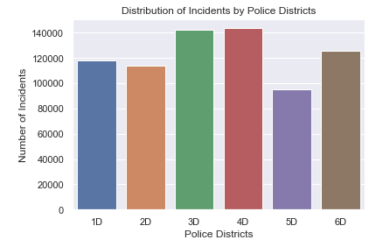
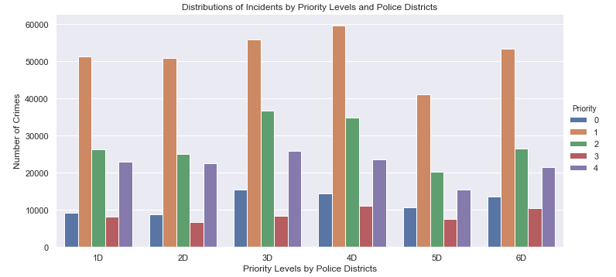
Exploratory Data Analysis
Insight #1: Distribution of Incidents by Police Districts
Insight #2: Distribution of Incidents by Priority Levels and Police Districts
Notes:
1D – Rockville, 2D – Bethesda, 3D – Silver Spring, 4D – Wheaton, 5D – Germantown, 6D – Montgomery Village

Slide 7
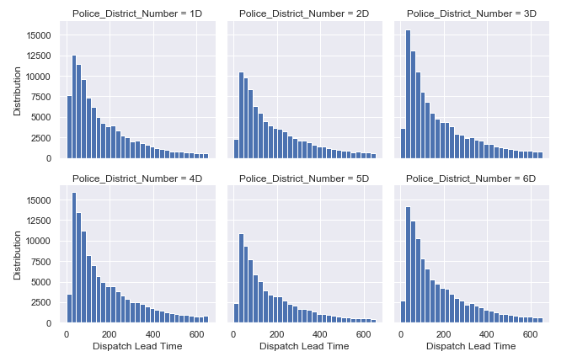
Exploratory Data Analysis
Insight #3: Relationship between Police Districts and Dispatch Lead-time
Expected result: The dispatch lead time should be equal among the police districts
One-way ANOVA test
ANOVA tests (with and without outliers) have the p-value that is significantly below 0.05: there is a relationship between police districts and dispatch lead-time
Dispatch lead-time: 75% quantile is 7 minutes
Notes:
The one-way ANOVA test is not much affected if the data distribution is skewed unless the group sizes are small. The distributions of the groups are similar, we can still apply the ANOVA method despite the fact that they are not normal.

Slide 8
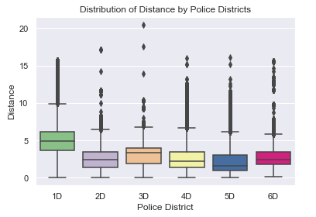
Exploratory Data Analysis
Insight #4: Relationship between Police Districts and Distances
Expected result: The travel distances should be equal among police districts
ANOVA test has the p-value that is significantly below 0.05: there is a relationship between police districts and distance between the stations and the incident locations
1D district (Rockville) has a higher median of 5 miles compared to the other districts

Slide 9
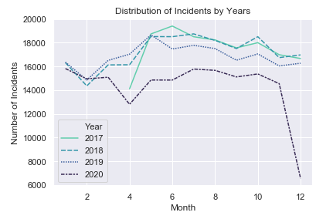
Final Data Products Product #1: Forecast of the number of calls received in 2021
2017, 2018 and 2019: the same pattern that shows a lower number of incidents in January, gradually increases in May and fluctuates for the rest of the year
2020: has lowest with a drop to under 10,000 cases in April and has the lowest number of incidents
SARIMAX vs Facebook Prophet
Scenario #1: Exclude 2020 data
Scenario #2: Include 2020 data

Slide 10
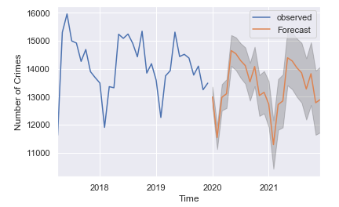
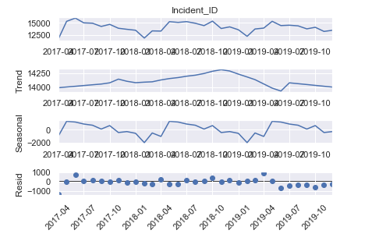
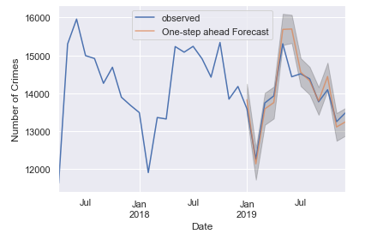
Final Data Products Product #1: Forecast of the number of calls received in 2021
Scenario #1: Excludes the 2020 data
MSE - mean squared error measures the average of the squares of the errors: 322,113.39
RMSE - Root Mean Square Error: 567.55
Downward trend in 2020 and 2021
Notes:
Re’sidual

Slide 11
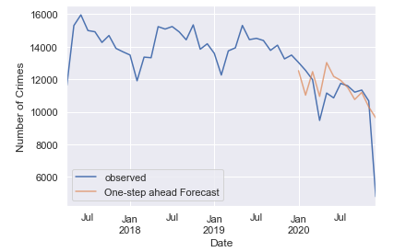
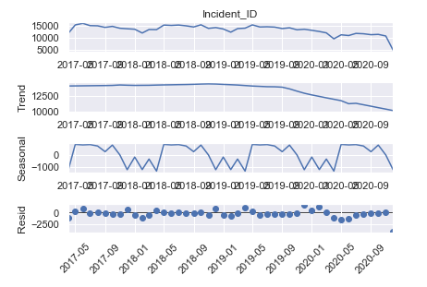
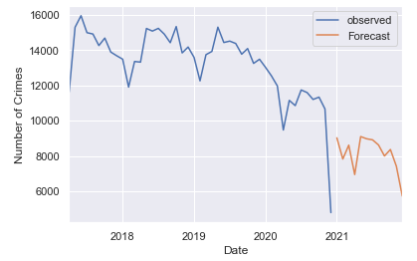
Final Data Products Product #1: Forecast of the number of calls received in 2021
Scenario #2: Includes the 2020 data
MSE - mean squared error measures the average of the squares of the errors: 3,894,121.54
RMSE - Root Mean Square Error: 1,973.35
Distorted pattern of the 2020 data impacts the 2021 predictions significantly

Slide 12
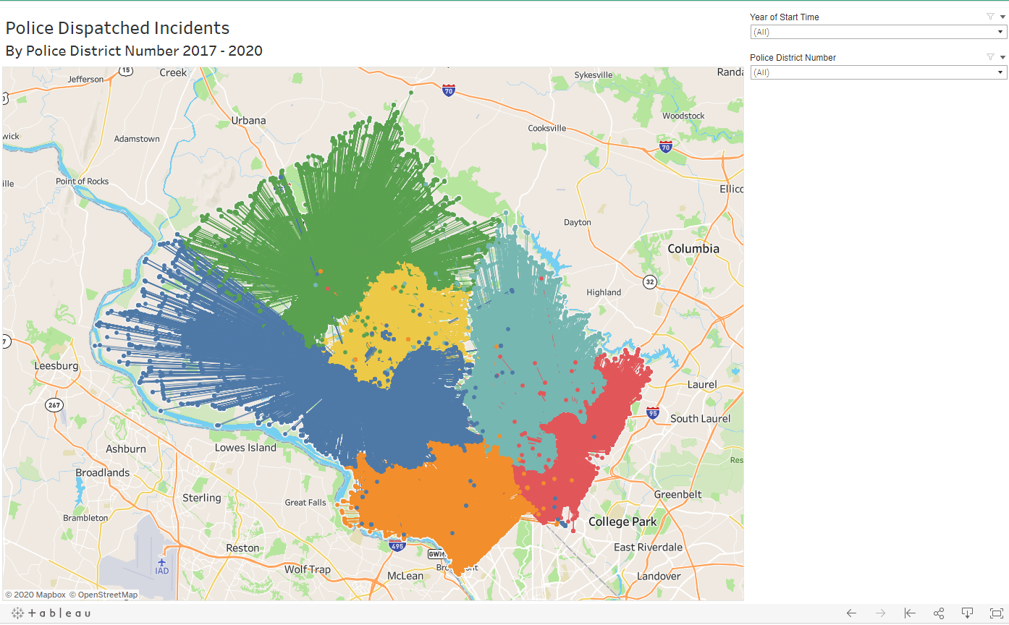
Final Data Products Product #2: Optimal Location of Police District
5D – Germantown
1D - Rockville
6D – Montgomery Village
4D - Wheaton
3D – Silver Spring
2D - Bethesda
Notes:
Police Dispatched Incident Mapping - Minh Tu Bui | Tableau Public

Slide 13
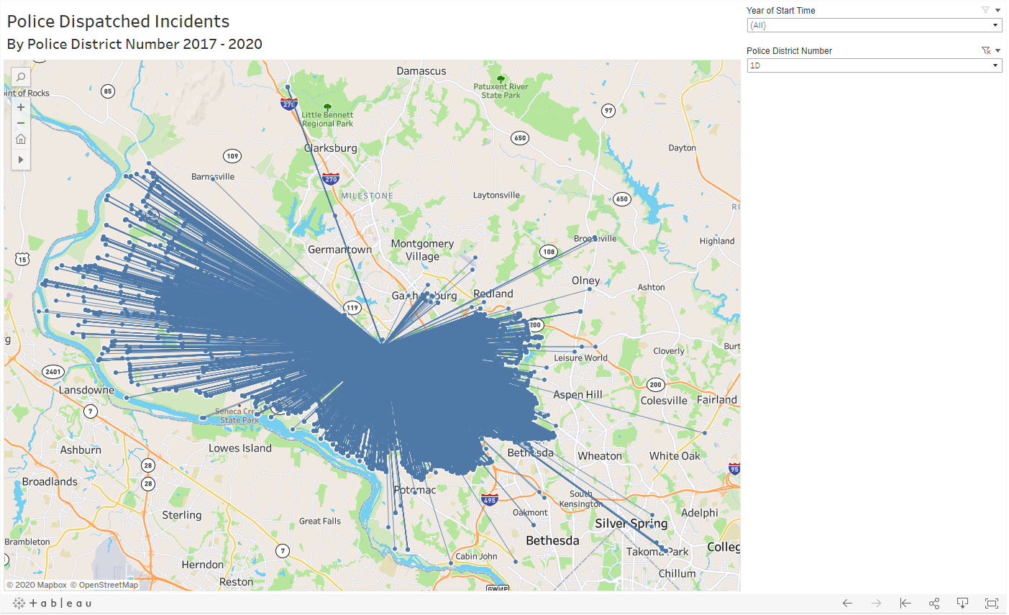
Final Data Products Product #2: Optimal Location of Police District
1D - Rockville

Slide 14
Final Data Products Product #2: Optimal Location of Police District
Aim at the geographic midpoint of the incident locations (latitude and longitude)
Use Shapely package in Python
Manipulation of planar features using functions from widely deployed GEOS library
object.centroid(): returns a representation of the centroid of a list of points
Use Vincenty formula to re-calculate the distance for comparison
Scenario #1: Re-locate the current Rockville police station
Scenario #2: Add an additional station near Dickerson and Poolesville cities

Slide 15
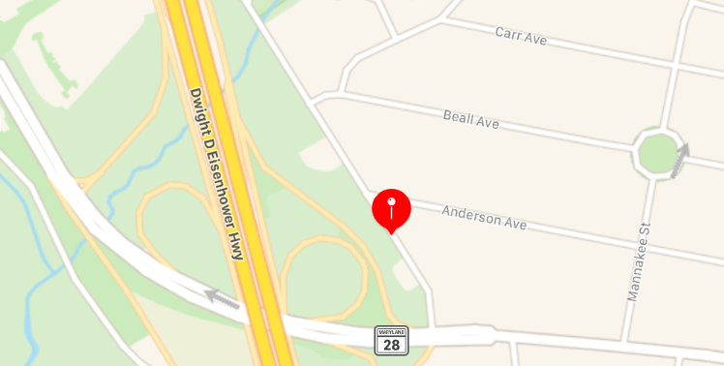
Final Data Products Product #2: Optimal Location of Police District
Scenario #1: Re-locate the current Rockville police station
Include Dickerson: (39.08698842115972, -77.17312171201968)
Nelson St, Rockville, MD 20850
Outliers: Dickerson (538), Poolesville (69), Beallsville (4)
Notes:
MCPD District 1 100 Edison Park Drive Gaithersburg, Maryland 20878
Find my district page, Montgomery county Police Department, Montgomery County,MD

Slide 16
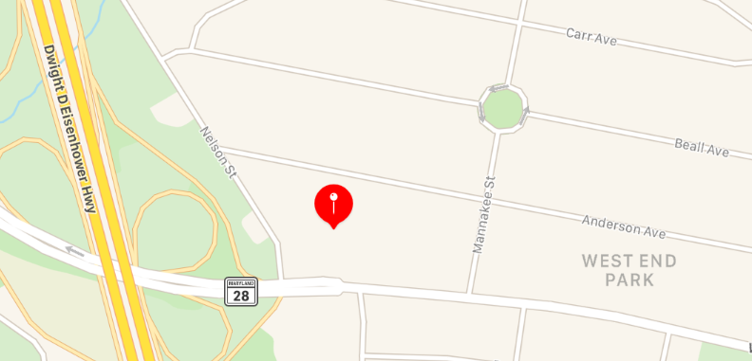
Final Data Products Product #2: Optimal Location of Police District
Scenario #1: Re-locate the current Rockville police station
Exclude Dickerson: (39.08642929256423, -77.17150852189418)
W Montgomery Ave, Rockville, MD 20850
Outliers: Poolesville (78) and Beallsville (4)
Notes:
GPS Coordinates - Latitude and Longitude Finder (gps-coordinates.org)

Slide 17
Final Data Products Product #2: Optimal Location of Police District
Scenario #1: Re-locate the current Rockville police station
 | Current Location | Include Dickerson | Exclude Dickerson
Count | 117,754 | 117,754 | 117,064
Mean | 4.967951 | 2.823915 | 2.724799
Std | 1.940806 | 2.427731 | 2.223563
Min | 0.02700000 | 0.03200000 | 0.05800000
25% | 3.63200000 | 1.46800000 | 1.42700000
50% | 4.95600000 | 2.20100000 | 2.15600000
75% | 6.15300000 | 3.33100000 | 3.24200000
Max | 15.6250000 | 19.2440000 | 16.3120000

Slide 18
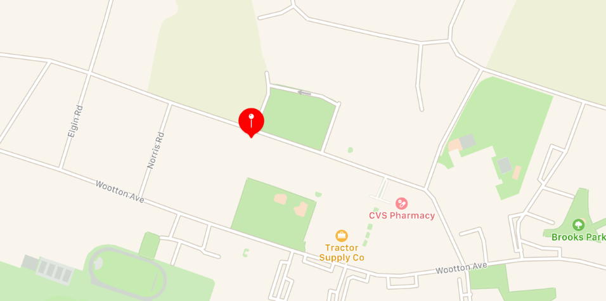
Final Data Products Product #2: Optimal Location of Police District
Scenario #2: Add an additional station near Dickerson, Poolesville, and Beallsville
(39.14462757071232, -77.412534064027)
Fisher Ave, Poolesville, MD 20837

Slide 19
Final Data Products Product #2: Optimal Location of Police District
Scenario #2: Add an additional station near Dickerson, Poolesville, and Beallsville
 | Station 1 (Current Location) | Station 2 (Near Dickerson)
Count | 114,131 | 3,623
Mean | 4.810430 | 1.962484
Std | 1.725272 | 1.804171
Min | 0.02700000 | 0.008000
25% | 3.584000 | 0.44500000
50% | 4.890000 | 1.13700000
75% | 6.057000 | 3.54900000
Max | 15.62500000 | 6.55800000

Slide 20
Limitations
Tested methods for time-series forecasting: SARIMAX and Facebook Prophet
Need close scrutiny of the 2020 data – trend, seasonality and bias
Simplistic approach in finding the optimal location of the police station
Assumption: Patrol police dispatch directly from stations
Need to understand the algorithm used to dispatch patrol police
Need to address the realistic resource capacity and financial constraints

Slide 21
Research Outlook
Apply more time-series forecasting methods to evaluate and compare the quality of each method
Impact analysis of the pandemic
Evaluate the resource utilization at each police station using simulations based on lead-time records
Data quality: some observations of distance and dispatch lead-time are significantly high, need more discussion

Slide 22
Special Thanks to:
Professor Michael Iapalucci
Professor Abdirisak Mohamed
Professor Rachel Saidi
Mr. Darren Dobkin
Ms. Karla Thomas
Mr. Neil Shorb

Slide 23
Thank you for listening

